Slide 1
C Operators
Programming Fundamentals (CSC103)
Lecture 4
Instructor: Yasher Ali

Slide 2
Table of Contents
Operators
Types of Operators
Unary Operators
Types of Unary Operators
Arithmetic Operators
Examples

Slide 3
Operators 1
Operators are the special symbols used to perform mathematical and logical operations to the given numbers or operands and returns results based on passed operator between the operands.
In other words, we can say that an operator operates the operands. For example, ‘+’ is an operator used for addition, as shown below:
sum=a+b;
Types of operators in C:
Unary Operators
Binary Operators
Ternary Operator

Slide 4
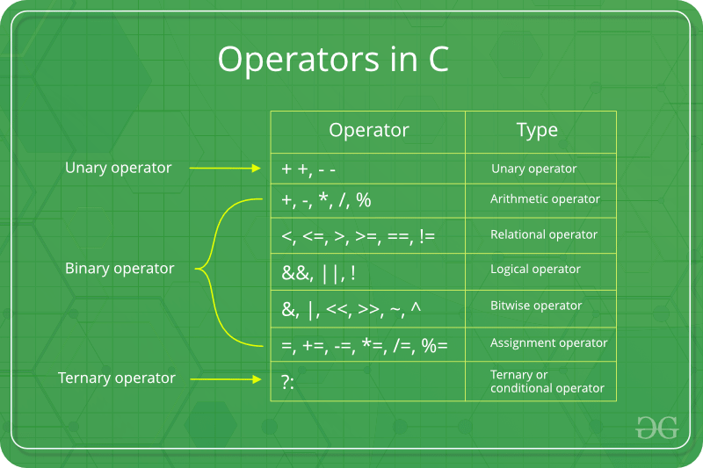
Operators 2

Slide 5
Unary Operator 1
A unary operator is an operator used to operate on a single operand to return a new value.
In other words, it is an operator that updates the value of an operand or expression's value by using the appropriate unary operators.
In Unary Operator, operators have equal priority from right to left side associativity.
Types of the Unary Operator
Following are the types of the unary operators in the C programming language.
Unary Minus (-)
Unary Plus (+)
Increment (++)
Decrement (--)
Logical Negation (!)
Address Operator (&)
sizeof() operator

Slide 6

Unary Minus (-)
The Unary Minus operator is represented using the symbol (-).
The unary operator is used to change the sign of any positive value to a negative value.
It means it changes the positive number to the negative, and a negative number becomes the positive number using the unary minus operator.
Syntax

Slide 7
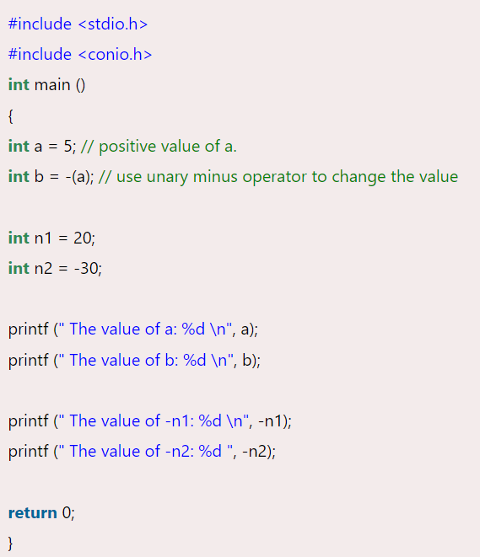
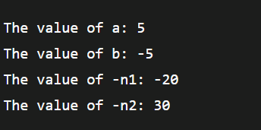
Unary Minus (-): Example
Output

Slide 8
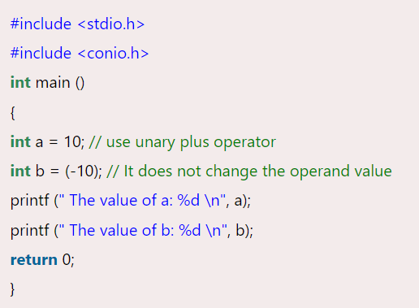
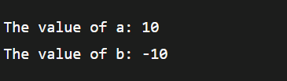
Unary Plus (+)
The unary plus operator is represented as the "+" symbol, and it does not change to the operand value.
Example
Output:

Slide 9

Unary Increment Operator (++) 1
It is the unary increment operator, which is denoted by the "++" symbol.
The "++" symbol represents the operand's value is increased by 1.
It can be used in two ways, as the post-increment and the pre-increment.
Pre Increment: The pre-increment operator is represented as (++a), which means the value of variable 'a' is increment by 1 before using operand to the expression.
For example:
The initial value of x is 10, and using the pre-increment operator (++x) increases the operand value by 1 before assigning it to the variable 'A'.

Slide 10

Unary Increment Operator (++) 2
Post Increment: The (a++) symbol represents the post-increment operator, which means the value of 'a' is incremented by 1 after assigning the original value to the expression or another variable.
Example
Here the initial value of the x variable is 10 and using the post-increment operator (x++) to assign increment value of the 'x' to the variable 'A'

Slide 11
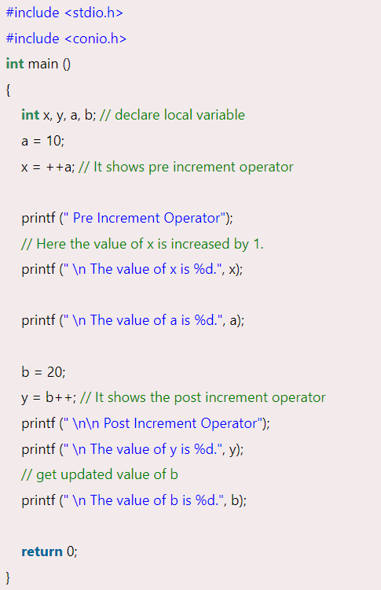
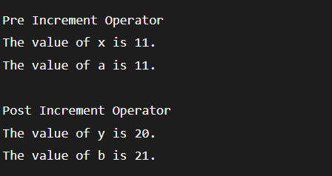
Unary Increment Operator (++) 3
Output:

Slide 12
Unary Decrement Operator (--) 1
The unary decrement operator is opposite to the unary increment operator.
The Unary decrement operator is represented by the double minus (--) symbol, and it is used to decrease the operand value by 1 according to the decrement's types.
The Unary decrement operator is of two types:
The Pre decrement operator and the Post Decrement operator.
Pre Decrement: The pre decrement operator is denoted as (--a) symbol, meaning the operand value is decreased by 1 before assigning to another variable or expression.
Post Decrement: The Post decrement operator is denoted as (a--) symbol, which means the original value is decreased by 1 after assigning to another variable or expression.

Slide 13
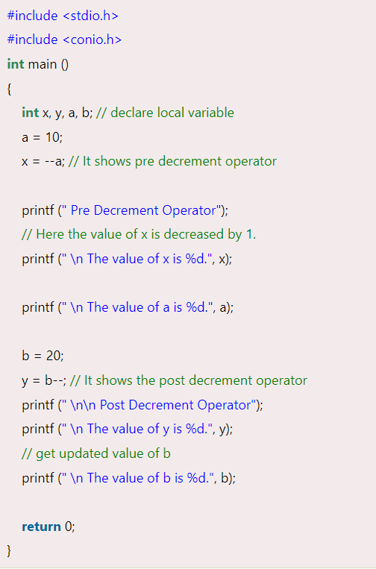
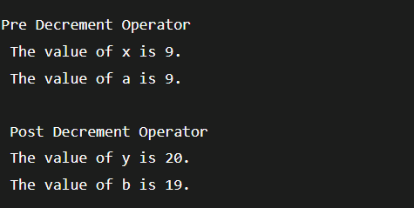
Unary Decrement Operator (--) 2
Output:

Slide 14
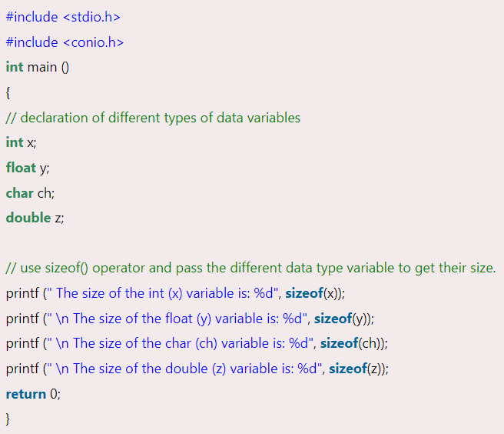
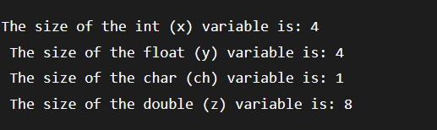
Unary sizeof() Operator
The sizeof is a keyword used to find the size of different data types or operands like int, float, char, double, etc.
Syntax: sizeof(data_variable);
Output:

Slide 15

Logical Not (!) Operator 1
The logical not operator is used to reverse the given condition.
For example, if the operand is true, the logical not operator (!) reverses and return false; if the operand is false, the logical operator returns true.
Syntax:

Slide 16
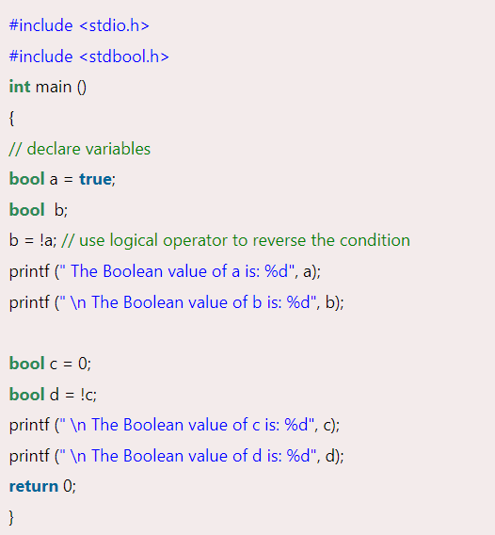
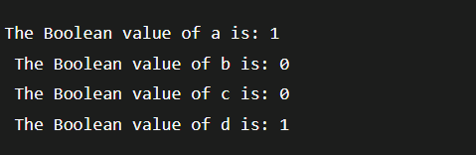
Logical Not (!) Operator 2
Output:

Slide 17

AddressOf Operator (&) 1
The Unary AddressOf Operator is denoted as ampersand (&) symbol, which is used to find the address of a variable defined in computer memory.
Syntax:

Slide 18
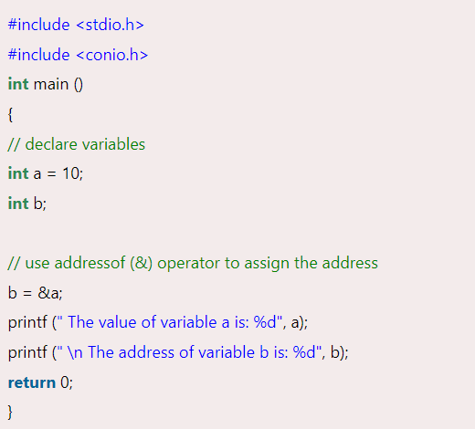

AddressOf Operator (&) 2
Output:

Slide 19
Arithmetic Operator in C 1
Arithmetic Operator is used to performing mathematical operations such as addition, subtraction, multiplication, division, modulus, etc., on the given operands.
For example: 5 + 3 = 8, 5 - 3 = 2, 2 * 4 = 8, etc. are the examples of arithmetic operators.
Let's discuss the different types of Arithmetic Operators in the C programming.
Plus Operator:
It is a simple Plus (+) Operator used to add two given operands.
We can use Plus Operator with different data types such as integer, float, long, double, enumerated and string type data to add the given operand.

Slide 20
Arithmetic Operator in C 2
Minus Operator:
The minus operator is denoted by the minus (-) symbol.
It is used to return the subtraction of the first number from the second number.
The data type of the given number can be different types, such as int, float, double, long double, etc., in the programing language.
Multiplication Operator:
The multiplication operator is represented as an asterisk (*) symbol, and it is used to return the product of n1 and n2 numbers.
The data type of the given number can be different types such as int, float, and double in the C programing language.

Slide 21
Arithmetic Operator in C 3
Division Operator:
The division operator is an arithmetic operator that divides the first (n1) by the second (n2) number.
Using division operator (/), we can divide the int, float, double and long data types variables.
Modulus Operator:
The modulus operator is represented by the percentage sign (%), and it is used to return the remainder by dividing the first number by the second number.

Slide 22
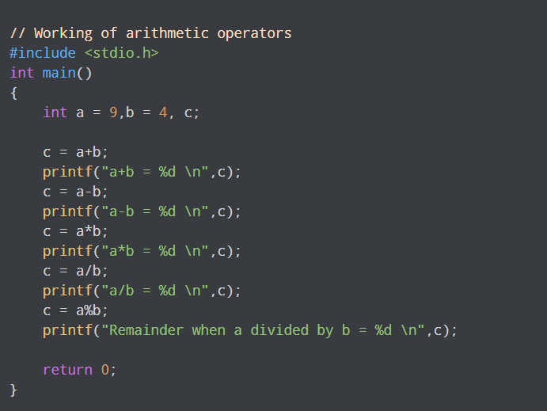
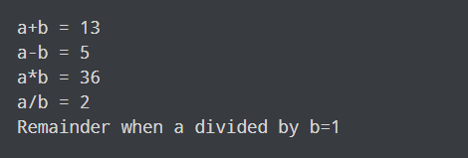
Arithmetic Operator in C 4
Example:
Output:

